Slide 1
COEN 243: Programming Methodology I Lecture 2: Control Flow (Part 1)

Slide 2
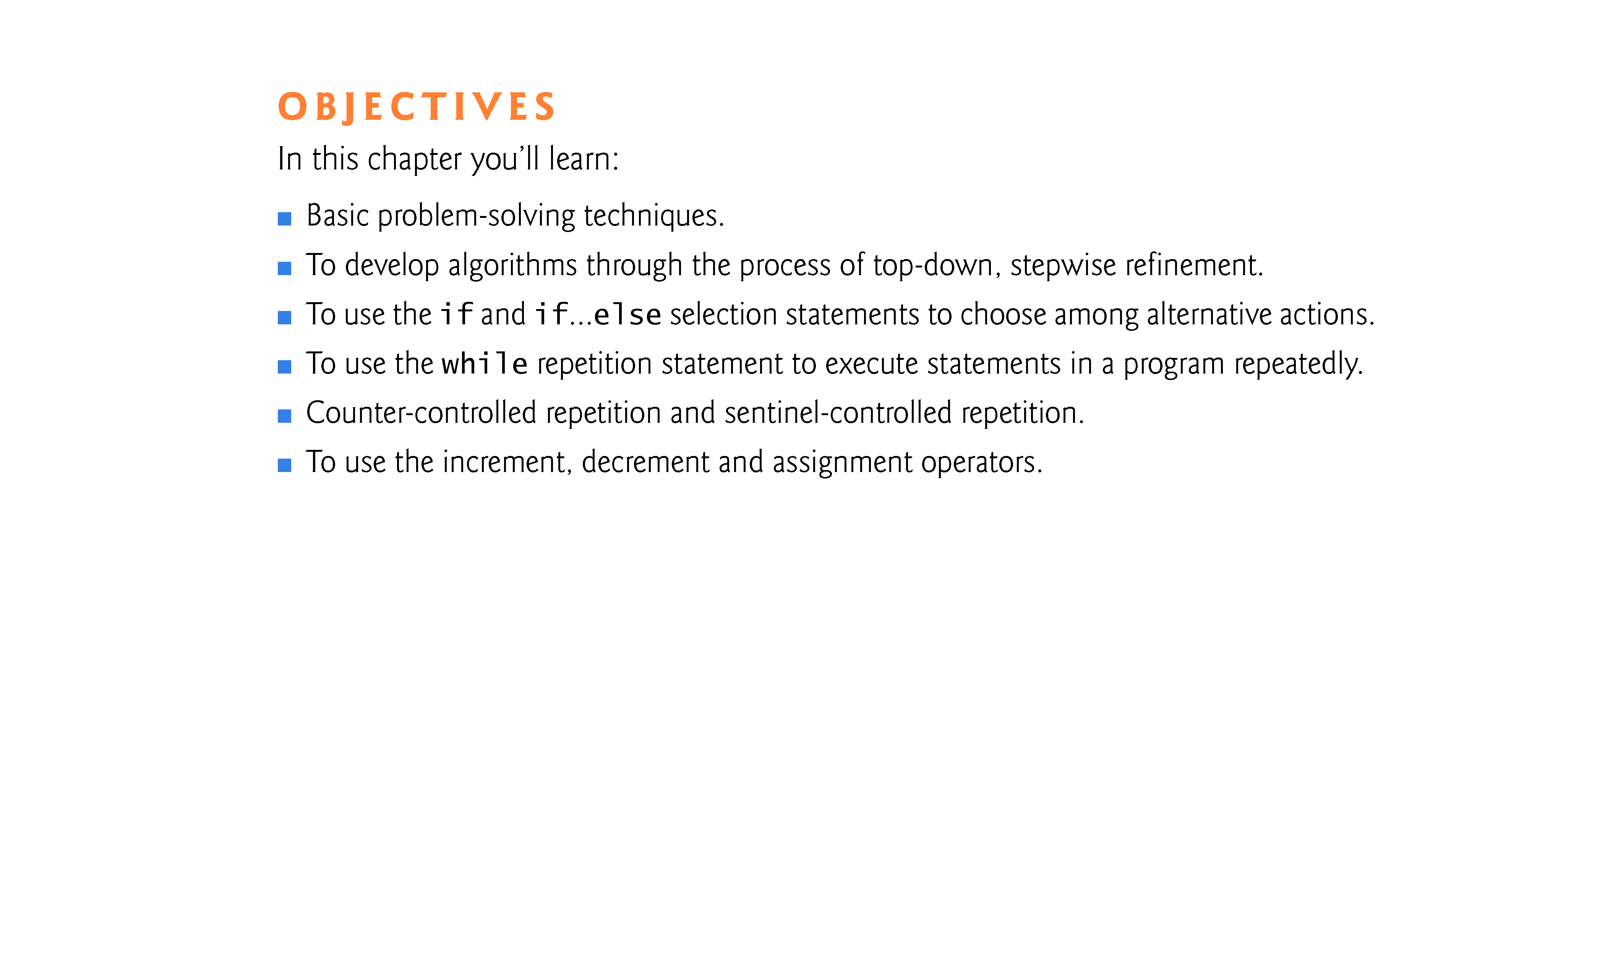

Slide 3
4.2 Algorithms
Any solvable computing problem can be solved by the execution a series of actions in a specific order.
An algorithm is procedure for solving a problem in terms of
the actions to execute and
the order in which the actions execute
Specifying the or-der in which statements (actions) execute in a computer program is called program control.
This chapter investigates program control using C++’s control statements.

Slide 4
4.4 Control Structures
Normally, statements in a program execute one after the other in the order in which they’re written.
Called sequential execution.
Various C++ statements enable you to specify that the next statement to execute may be other than the next one in sequence.
Called transfer of control.
All programs could be written in terms of only three control structures
the sequence structure
the selection structure and
the repetition structure
When we introduce C++’s implementations of control structures, we’ll refer to them in the terminology of the C++ standard document as “control statements.”

Slide 5
4.4 Control Structures (cont.)
C++ provides three types of selection statements (discussed in this chapter and Chapter 5).
The if selection statement either performs (selects) an action if a condition (predicate) is true or skips the action if the condition is false.
The if…else selection statement performs an action if a condition is true or performs a different action if the condition is false.
The switch selection statement (Chapter 5) performs one of many different actions, depending on the value of an integer expression.

Slide 6
4.4 Control Structures (cont.)
The if selection statement is a single-selection statement because it selects or ignores a single action (or, as we’ll soon see, a single group of actions).
The if…else statement is called a double-selection statement because it selects between two different actions (or groups of actions).
The switch selection statement is called a multiple-selection statement because it selects among many different actions (or groups of actions).

Slide 7
4.4 Control Structures (cont.)
C++ provides three types of repetition statements (also called looping statements or loops) for performing statements repeatedly while a condition (called the loop-continuation condition) remains true.
These are the while, do…while and for statements.
The while and for statements perform the action (or group of actions) in their bodies zero or more times.
The do…while statement performs the action (or group of actions) in its body at least once.

Slide 8
4.4 Control Structures (cont.)
Each of the words if, else, switch, while, do and for is a C++ keyword.
These words are reserved by the C++ programming language to implement various features, such as C++’s control statements.
Keywords cannot be used as identifiers, such as variable names.
Figure 4.3 provides a complete list of C++ keywords-.

Slide 9
4.4 Control Structures (cont.)
Each program combines as many of each of these control statements as appropriate for the algorithm the program implements.
We can model each control statement as an activity diagram with initial and final states representing that control statement’s entry and exit points, respectively.
Single-entry/single-exit control statements
Control statements are attached to one another by connecting the exit point of one to the entry point of the next.
Called control-statement stacking.
Only one other way to connect control statements—called control-statement nesting, in which one control statement is contained inside another.

Slide 10
4.5 if Selection Statement (cont.)
A decision can be based on any expression—if the expression evaluates to zero, it’s treated as false; if the expression evaluates to nonzero, it’s treated as true.
C++ provides the data type bool for variables that can hold only the values true and false—each of these is a C++ keyword.

Slide 11
4.6 if…else Double-Selection Statement
if…else double-selection statement
specifies an action to perform when the condition is true and a different action to perform when the condition is false.
The following pseudocode prints “Passed” if the student’s grade is greater than or equal to 60, or “Failed” if the student’s grade is less than 60.
If student’s grade is greater than or equal to 60 Print “Passed” Else Print “Failed”

Slide 12
4.6 if…else Double-Selection Statement
In either case, after printing occurs, the next pseudocode statement in sequence is “performed.”
The preceding pseudocode If…Else statement can be written in C++ as
if ( grade >= 60 ) cout << "Passed"; else cout << "Failed";

Slide 13
4.6 Nested if…else Double-Selection Statement (cont.)
Example
if ( studentGrade >= 90 ) // 90 and above gets "A" cout << "A"; else if ( studentGrade >= 80 ) // 80-89 gets "B" cout << "B"; else if ( studentGrade >= 70 ) // 70-79 gets "C" cout << "C"; else if ( studentGrade >= 60 ) // 60-69 gets "D" cout << "D"; else // less than 60 gets "F" cout << "F";

Slide 14
4.6 if…else Double-Selection Statement (cont.)
The C++ compiler always associates an else with the immediately preceding if unless told to do otherwise by the placement of braces ({ and }).
This behavior can lead to what’s referred to as the dangling-else problem.
if ( x > 5 ) if ( y > 5 ) cout << "x and y are > 5"; else cout << "x is <= 5";
appears to indicate that if x is greater than 5, the nested if statement determines whether y is also greater than 5.

Slide 15
4.6 if…else Double-Selection Statement (cont.)
The compiler actually interprets the statement as
if ( x > 5 ) if ( y > 5 ) cout << "x and y are > 5"; else cout << "x is <= 5";
To force the nested if…else statement to execute as intended, use:
if ( x > 5 ) { if ( y > 5 ) cout << "x and y are > 5"; } else cout << "x is <= 5";
Braces ({}) indicate that the second if statement is in the body of the first if and that the else is associated with the first if.

Slide 16
4.6 if…else Double-Selection Statement (cont.)
The if selection statement expects only one statement in its body.
Similarly, the if and else parts of an if…else statement each expect only one body statement.
To in-clude several statements in the body of an if or in either part of an if…else, enclose the statements in braces ({ and }).
A set of statements contained within a pair of braces is called a compound statement or a block.

Slide 17
4.7 while Repetition Statement
Consider a program segment designed to find the first power of 3 larger than 100. Suppose the integer variable product has been initialized to 3.
When the following while repetition statement finishes executing, product contains the result:
int product = 3; while ( product <= 100 ) product = 3 * product;

Slide 18
4.8 Formulating Algorithms: Counter-Controlled Repetition
Consider the following problem statement:
A class of ten students took a quiz. The grades (0 to 100) for this quiz are available to you. Calculate and display the total of the grades and the class average.
The class average is equal to the sum of the grades divided by the number of students.
The algorithm for solving this problem on a computer must input each of the grades, calculate the average and print the result.

Slide 19
4.8 Formulating Algorithms: Counter-Controlled Repetition (cont.)
We use counter-controlled repetition to input the grades one at a time.
This technique uses a variable called a counter to control the number of times a group of statements will execute (also known as the number of iterations of the loop).
Often called definite repetition because the number of repetitions is known before the loop begins executing.

Slide 20
4.8 Formulating Algorithms: Counter-Controlled Repetition (cont.)
A total is a variable used to accumulate the sum of several values.
A counter is a variable used to count—in this case, the grade counter indicates which of the 10 grades is about to be entered by the user.
Variables that are used to store totals are normally initialized to zero before being used in a program; otherwise, the sum would include the previous value stored in the total’s memory location.

Slide 21
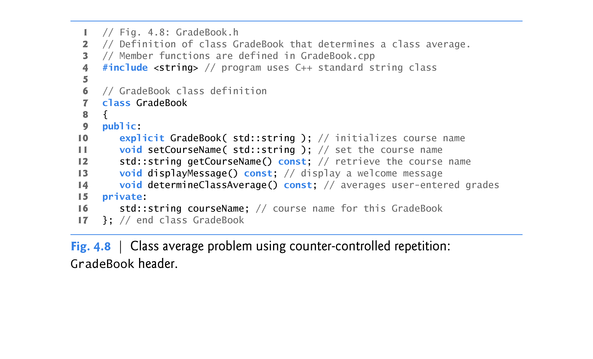

Slide 22
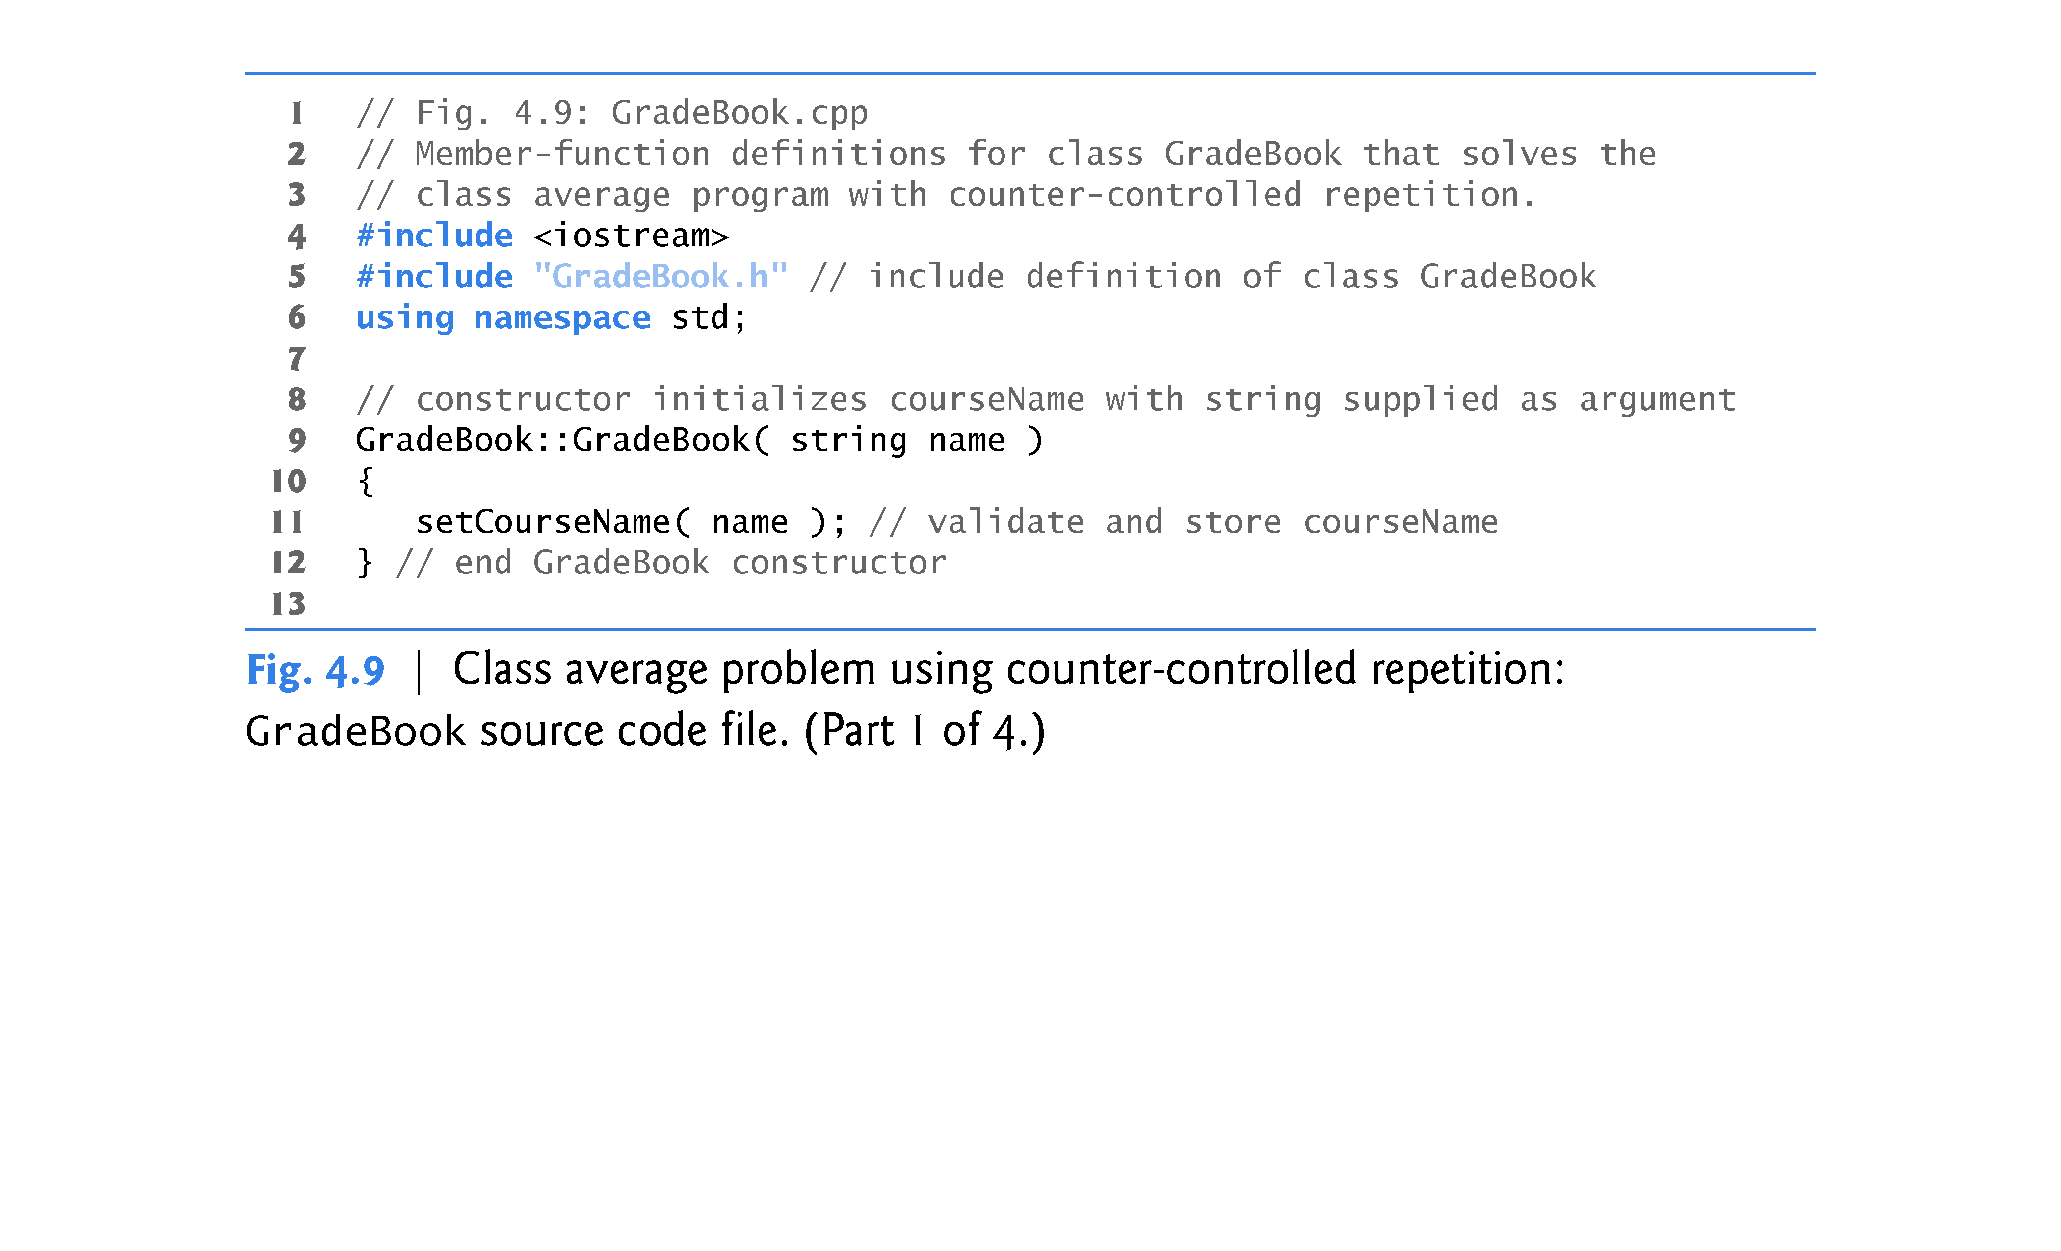

Slide 23
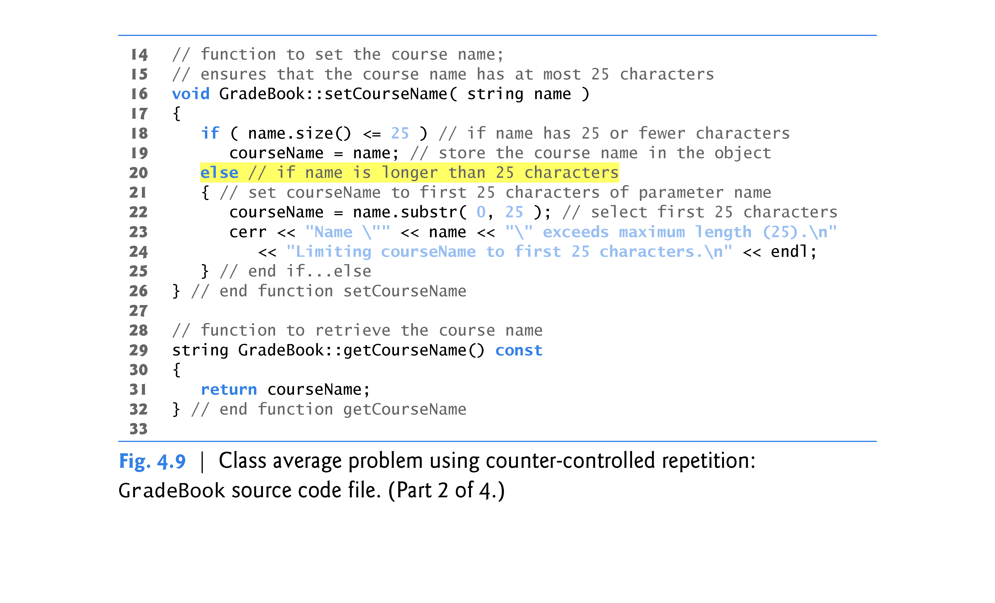

Slide 24
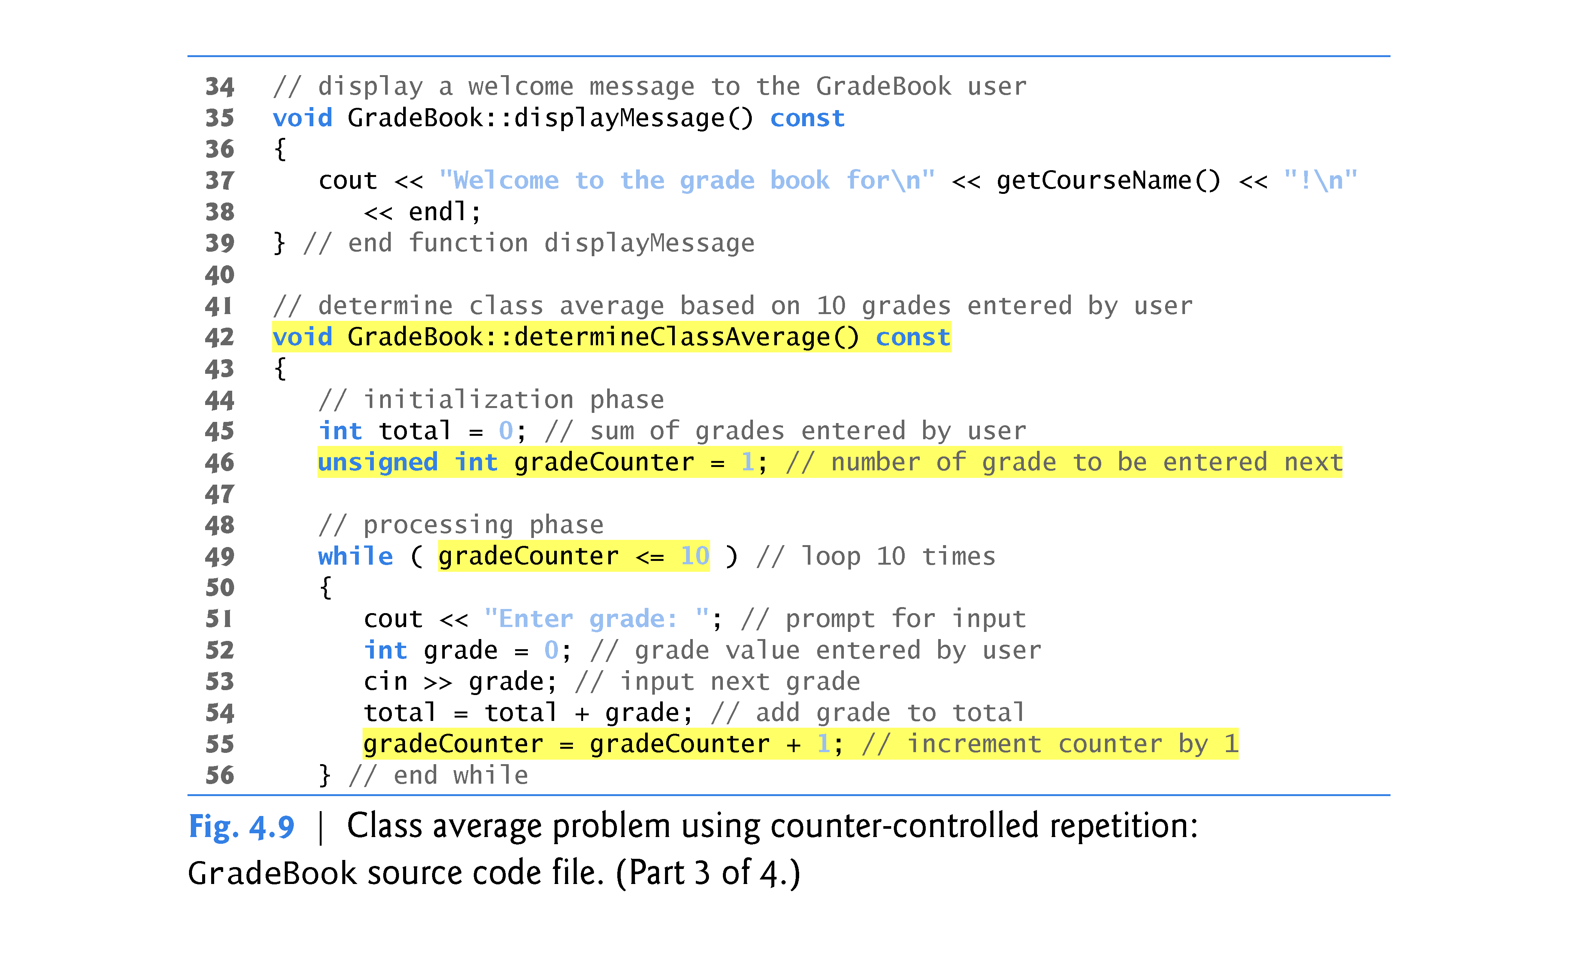

Slide 25
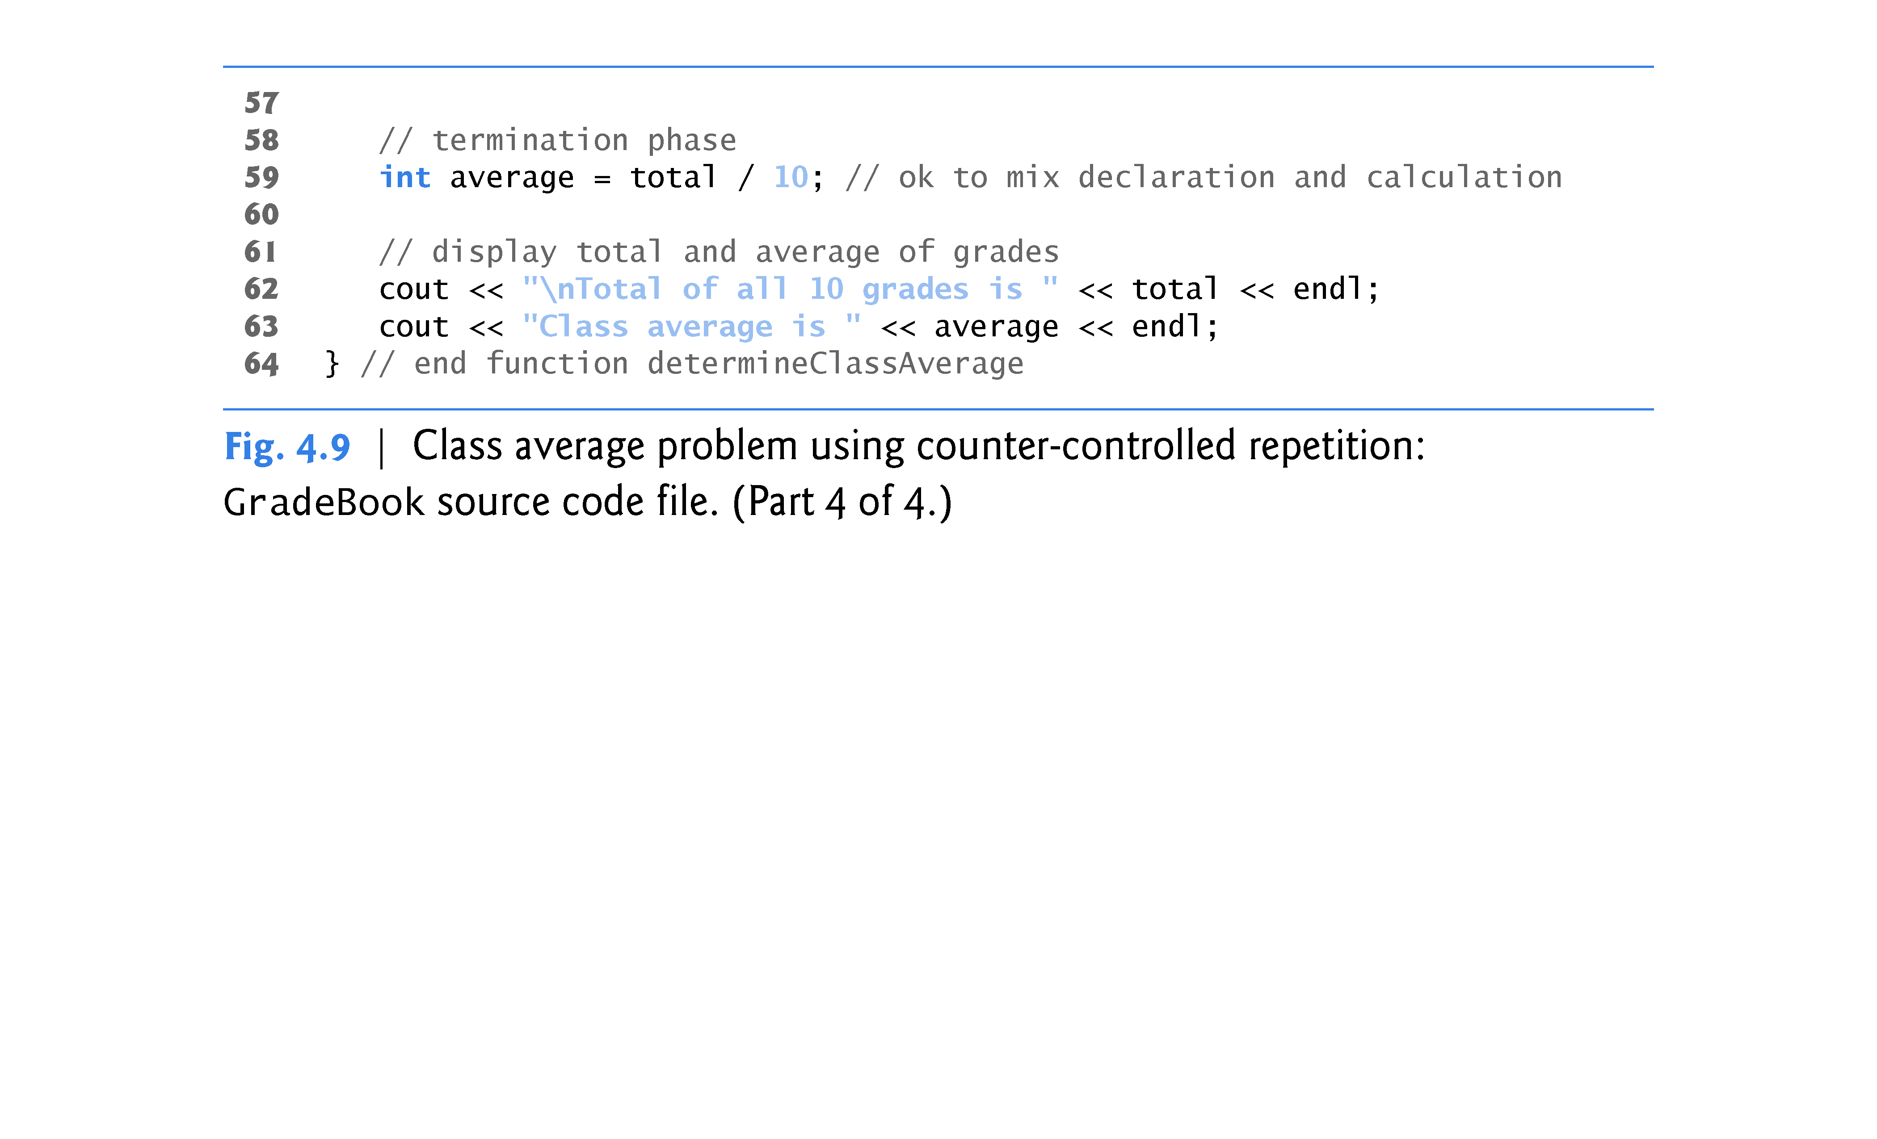

Slide 26
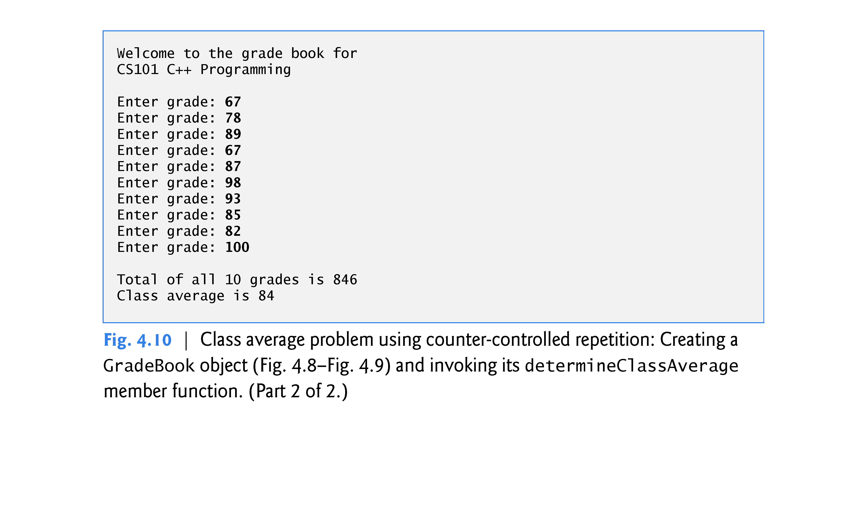

Slide 27
4.9 Formulating Algorithms: Sentinel-Controlled Repetition
Let’s generalize the class average problem.
Develop a class average program that processes grades for an arbitrary number of students each time it’s run.
The program must process an arbitrary number of grades.
How can the program determine when to stop the input of grades?
Can use a special value called a sentinel value (also called a signal value, a dummy value or a flag value) to indicate “end of data entry.”
Sentinel-controlled repetition is often called indefinite repetition
the number of repetitions is not known in advance.
The sentinel value must not be an acceptable input value.

Slide 28
4.9 Formulating Algorithms: Sentinel-Controlled Repetition (cont.)
An averaging calculation is likely to produce a number with a decimal point—a real number or floating-point number (e.g., 7.33, 0.0975 or 1000.12345).
Type int cannot represent such a number.
C++ provides several data types for storing floating-point numbers in memory, including float and double.
Compared to float variables, double variables can typically store numbers with larger magnitude and finer detail
more digits to the right of the decimal point—also known as the number’s precision.
Cast operator can be used to force the averaging calculation to produce a floating-point numeric result.

Slide 29
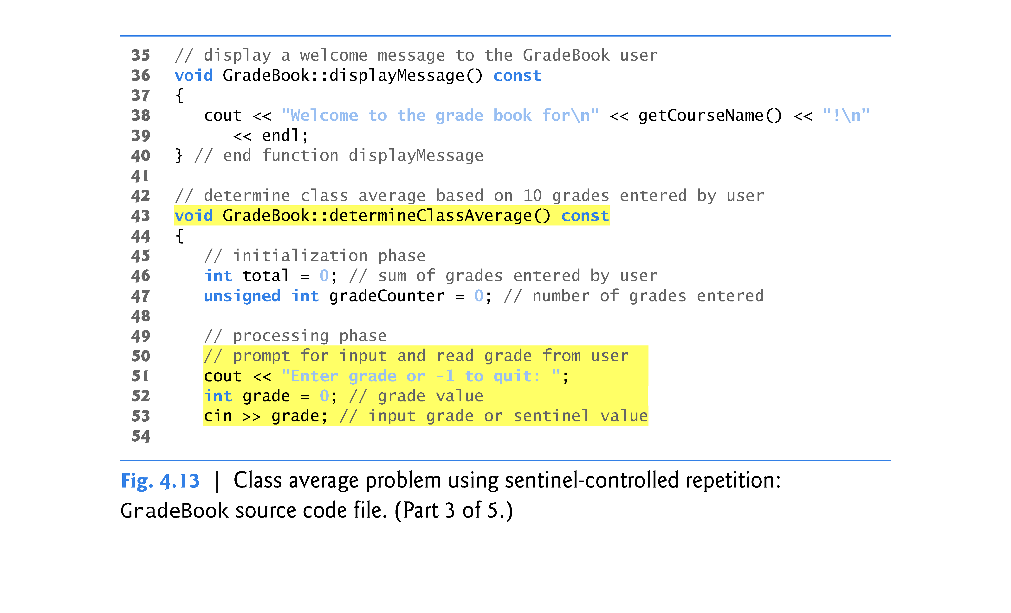

Slide 30
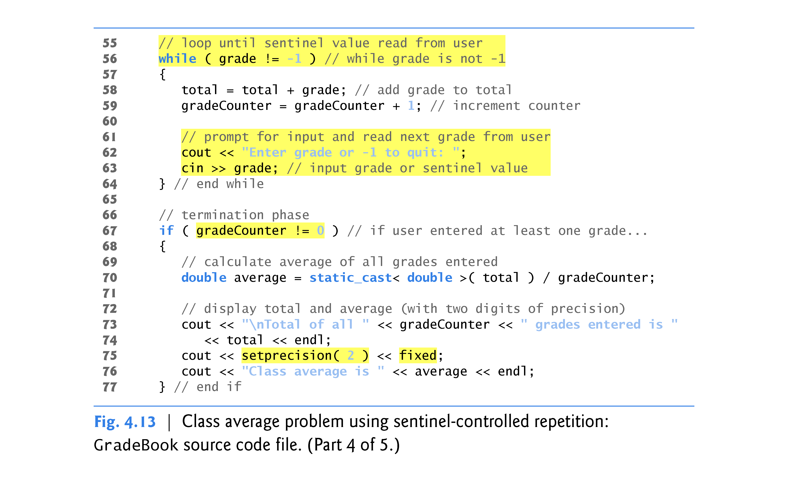

Slide 31
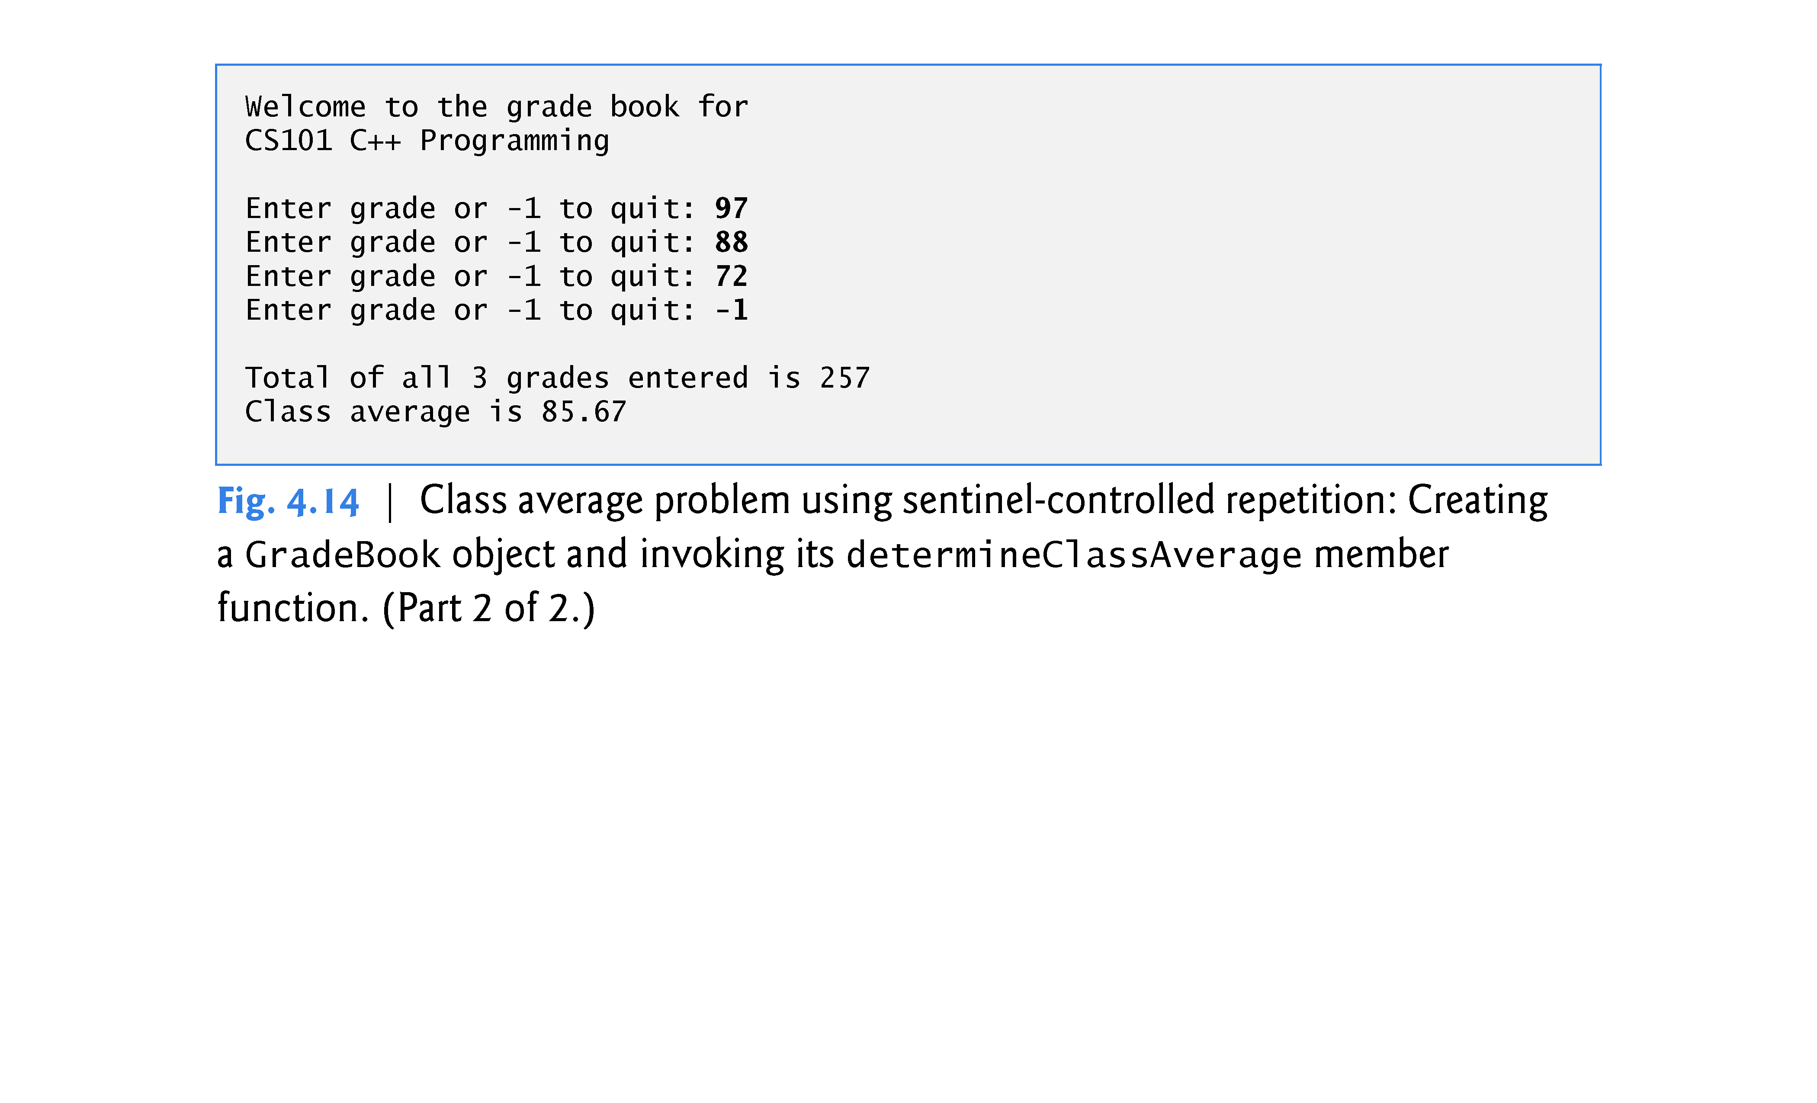

Slide 32
4.9 Formulating Algorithms: Sentinel-Controlled Repetition (cont.)
Notice the block in the while loop in Fig. 4.13.
Without the braces, the last three statements in the body of the loop would fall outside the loop, causing the computer to interpret this code incorrectly, as follows:
// loop until sentinel value read from user while ( grade != -1 ) total = total + grade; // add grade to total gradeCounter = gradeCounter + 1; // increment counter // prompt for input and read next grade from user cout << "Enter grade or -1 to quit: "; cin >> grade;
This would cause an infinite loop in the program if the user did not input –1 for the first grade (in line 57).

Slide 33
4.9 Formulating Algorithms: Sentinel-Controlled Repetition (cont.)
Variables of type float represent single-precision floating-point numbers and have seven significant digits on most of today’s systems.
Variables of type double represent double-precision floating-point numbers.
These require twice as much memory as float variables and provide 15 significant digits on most of today’s systems
Approximately double the precision of float variables
C++ treats all floating-point numbers in a program’s source code as double values by default.
Known as floating-point literals.
Floating-point numbers often arise as a result of division.

Slide 34
4.9 Formulating Algorithms: Sentinel-Controlled Repetition (cont.)
The variable average is declared to be of type double to capture the fractional result of our calculation.
total and gradeCounter are both integer variables.
Recall that dividing two integers results in integer division, in which any fractional part of the calculation is lost (i.e., truncated).
In the following statement the division occurs first—the result’s fractional part is lost before it’s assigned to average:
average = total / gradeCounter;

Slide 35
4.9 Formulating Algorithms: Sentinel-Controlled Repetition (cont.)
To perform a floating-point calculation with integers, create temporary floating-point values.
static_cast operator accomplishes this task.
The cast operator static_cast<double>(total) creates a temporary floating-point copy of its operand in parentheses.
Known as explicit conversion.
The value stored in total is still an integer.

Slide 36
4.9 Formulating Algorithms: Sentinel-Controlled Repetition (cont.)
The calculation now consists of a floating-point value divided by the integer gradeCounter.
The compiler knows how to evaluate only expressions in which the operand types are identical.
Compiler performs promotion (also called implicit conversion) on selected operands.
In an expression containing values of data types int and double, C++ promotes int operands to double values.
Cast operators are available for use with every data type and with class types as well.

Slide 37
4.9 Formulating Algorithms: Sentinel-Controlled Repetition (cont.)
The call to setprecision in line 75 (with an argument of 2) indicates that double values should be printed with two digits of precision to the right of the decimal point (e.g., 92.37).
Parameterized stream manipulator (argument in parentheses).
Programs that use these must include the header <iomanip>.
endl is a nonparameterized stream manipulator and does not require the <iomanip> header file.
If the precision is not specified, floating-point values are normally output with six digits of precision.

Slide 38
4.9 Formulating Algorithms: Sentinel-Controlled Repetition (cont.)
Stream manipulator fixed indicates that floating-point values should be output in fixed-point format, as opposed to scientific notation.
Fixed-point formatting is used to force a floating-point number to display a specific number of digits.
Specifying fixed-point formatting also forces the decimal point and trailing zeros to print, even if the value is a whole number amount, such as 88.00.
Without the fixed-point formatting option, such a value prints in C++ as 88 without the trailing zeros and decimal point.

Slide 39
4.9 Formulating Algorithms: Sentinel-Controlled Repetition (cont.)
When the stream manipulators fixed and setprecision are used in a program, the printed value is rounded to the number of decimal positions indicated by the value passed to setprecision (e.g., the value 2 in line 75), although the value in memory re-mains unaltered.
It’s also possible to force a decimal point to appear by using stream manipulator showpoint.
If showpoint is specified without fixed, then trailing zeros will not print.
Both can be found in header <iostream>.

Slide 40
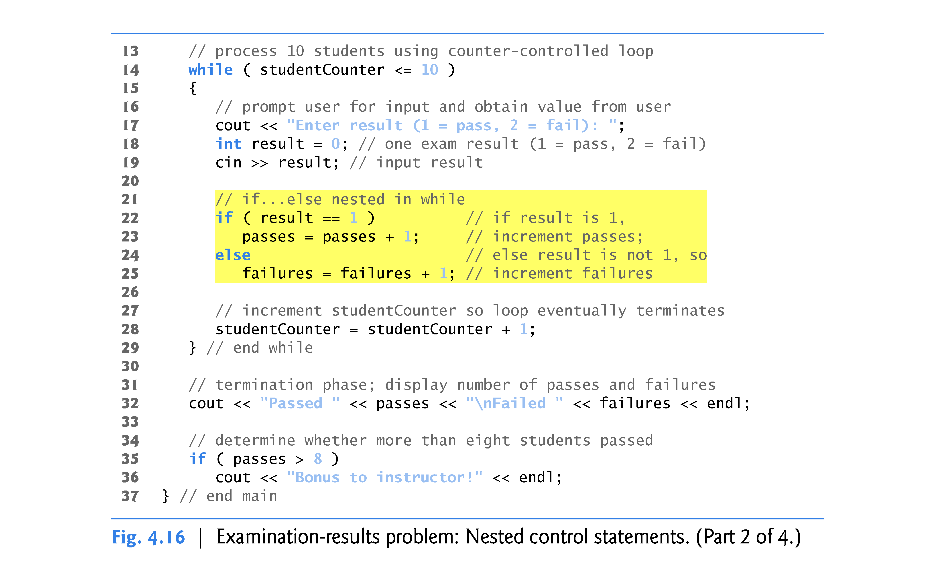

Slide 41
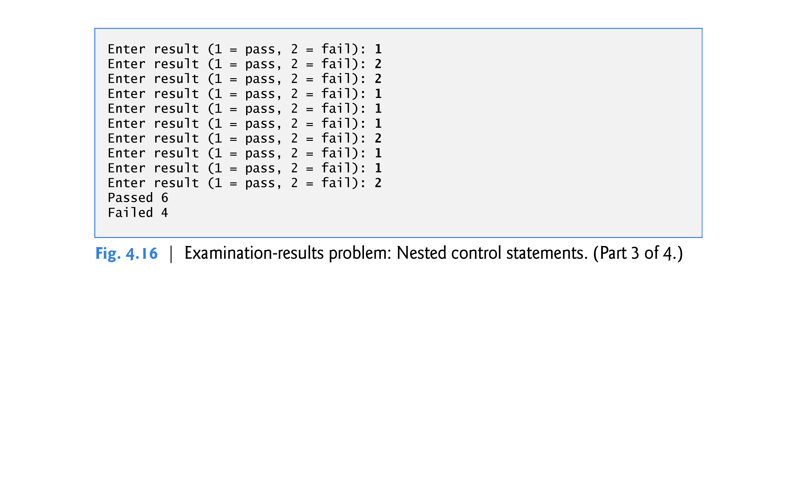

Slide 42
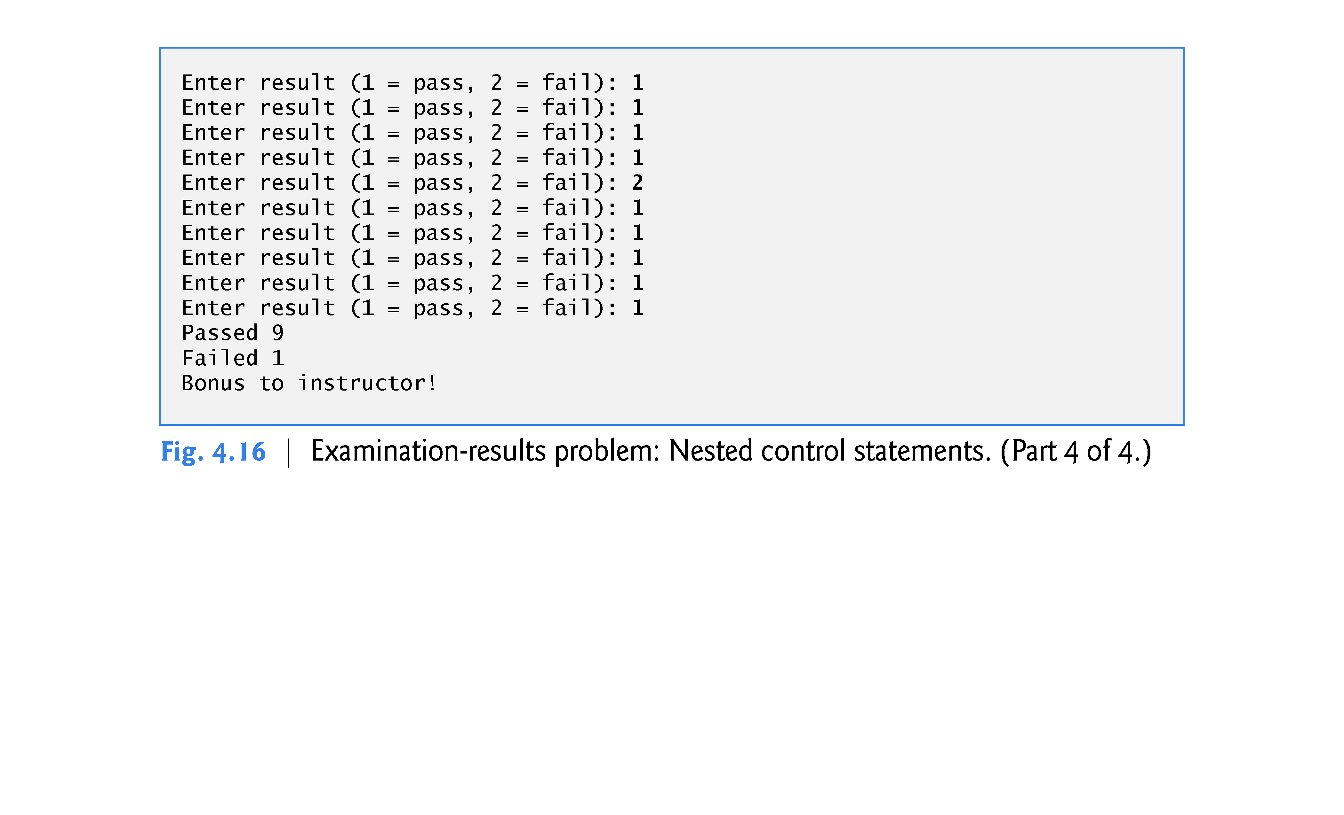

Slide 43
4.10 Formulating Algorithms: Nested Control Statements (cont.)
The if…else statement (lines 22–25) for processing each result is nested in the while statement.
The if statement in lines 35–36 determines whether more than eight students passed the exam and, if so, outputs the message "Bonus to instructor!".

Slide 44
4.10 Formulating Algorithms: Nested Control Statements (cont.)
The actual value assigned to x is 12.
Many compilers generate a warning for this statement, but still allow it to compile.
However, using list initialization, as in
int x = { 12.7 };
or
int x{ 12.7 };
yields a compilation error, thus helping you avoid a potentially subtle logic error. For example, Apple’s Xcode LLVM compiler gives the error
Type 'double' cannot be narrowed to 'int' in initializer list

Slide 45
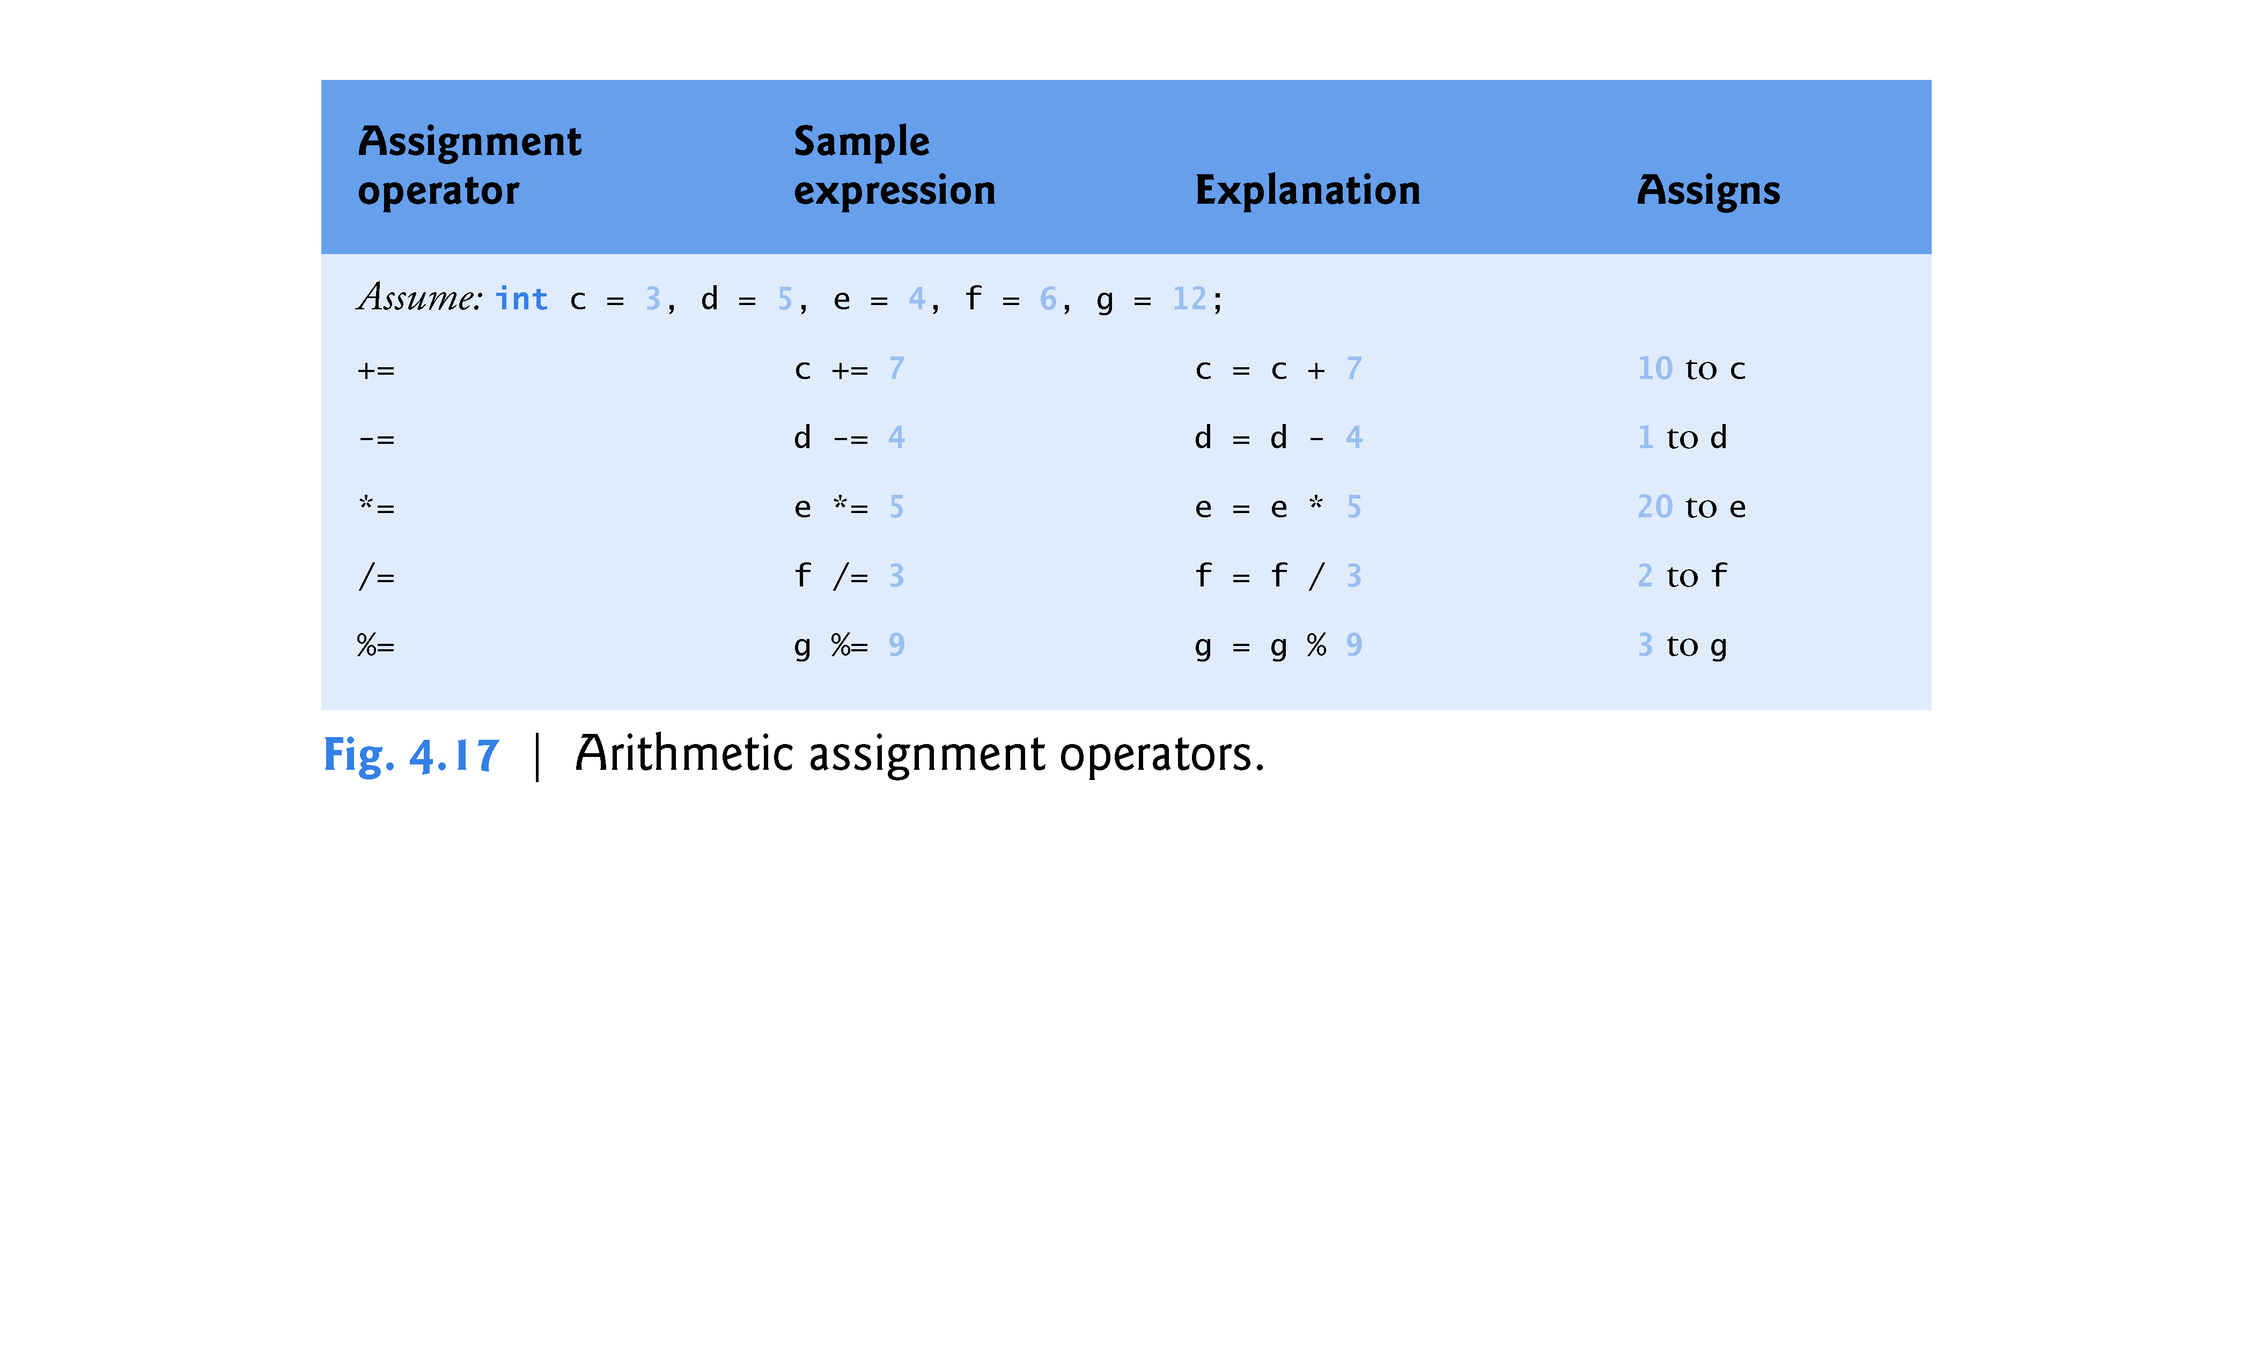

Slide 46
4.12 Increment and Decrement Operators
C++ also provides two unary operators for adding 1 to or subtracting 1 from the value of a numeric variable.
These are the unary increment operator, ++, and the unary decrement operator, --, which are summarized in Fig. 4.18.

Slide 47
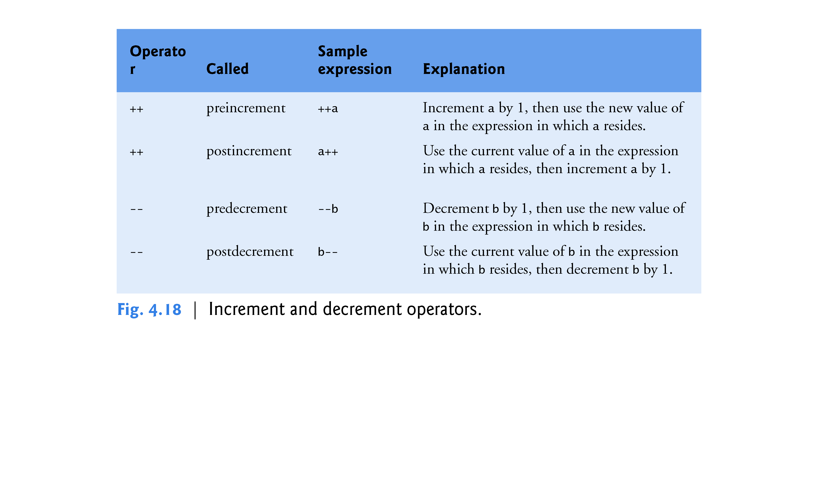

Slide 48
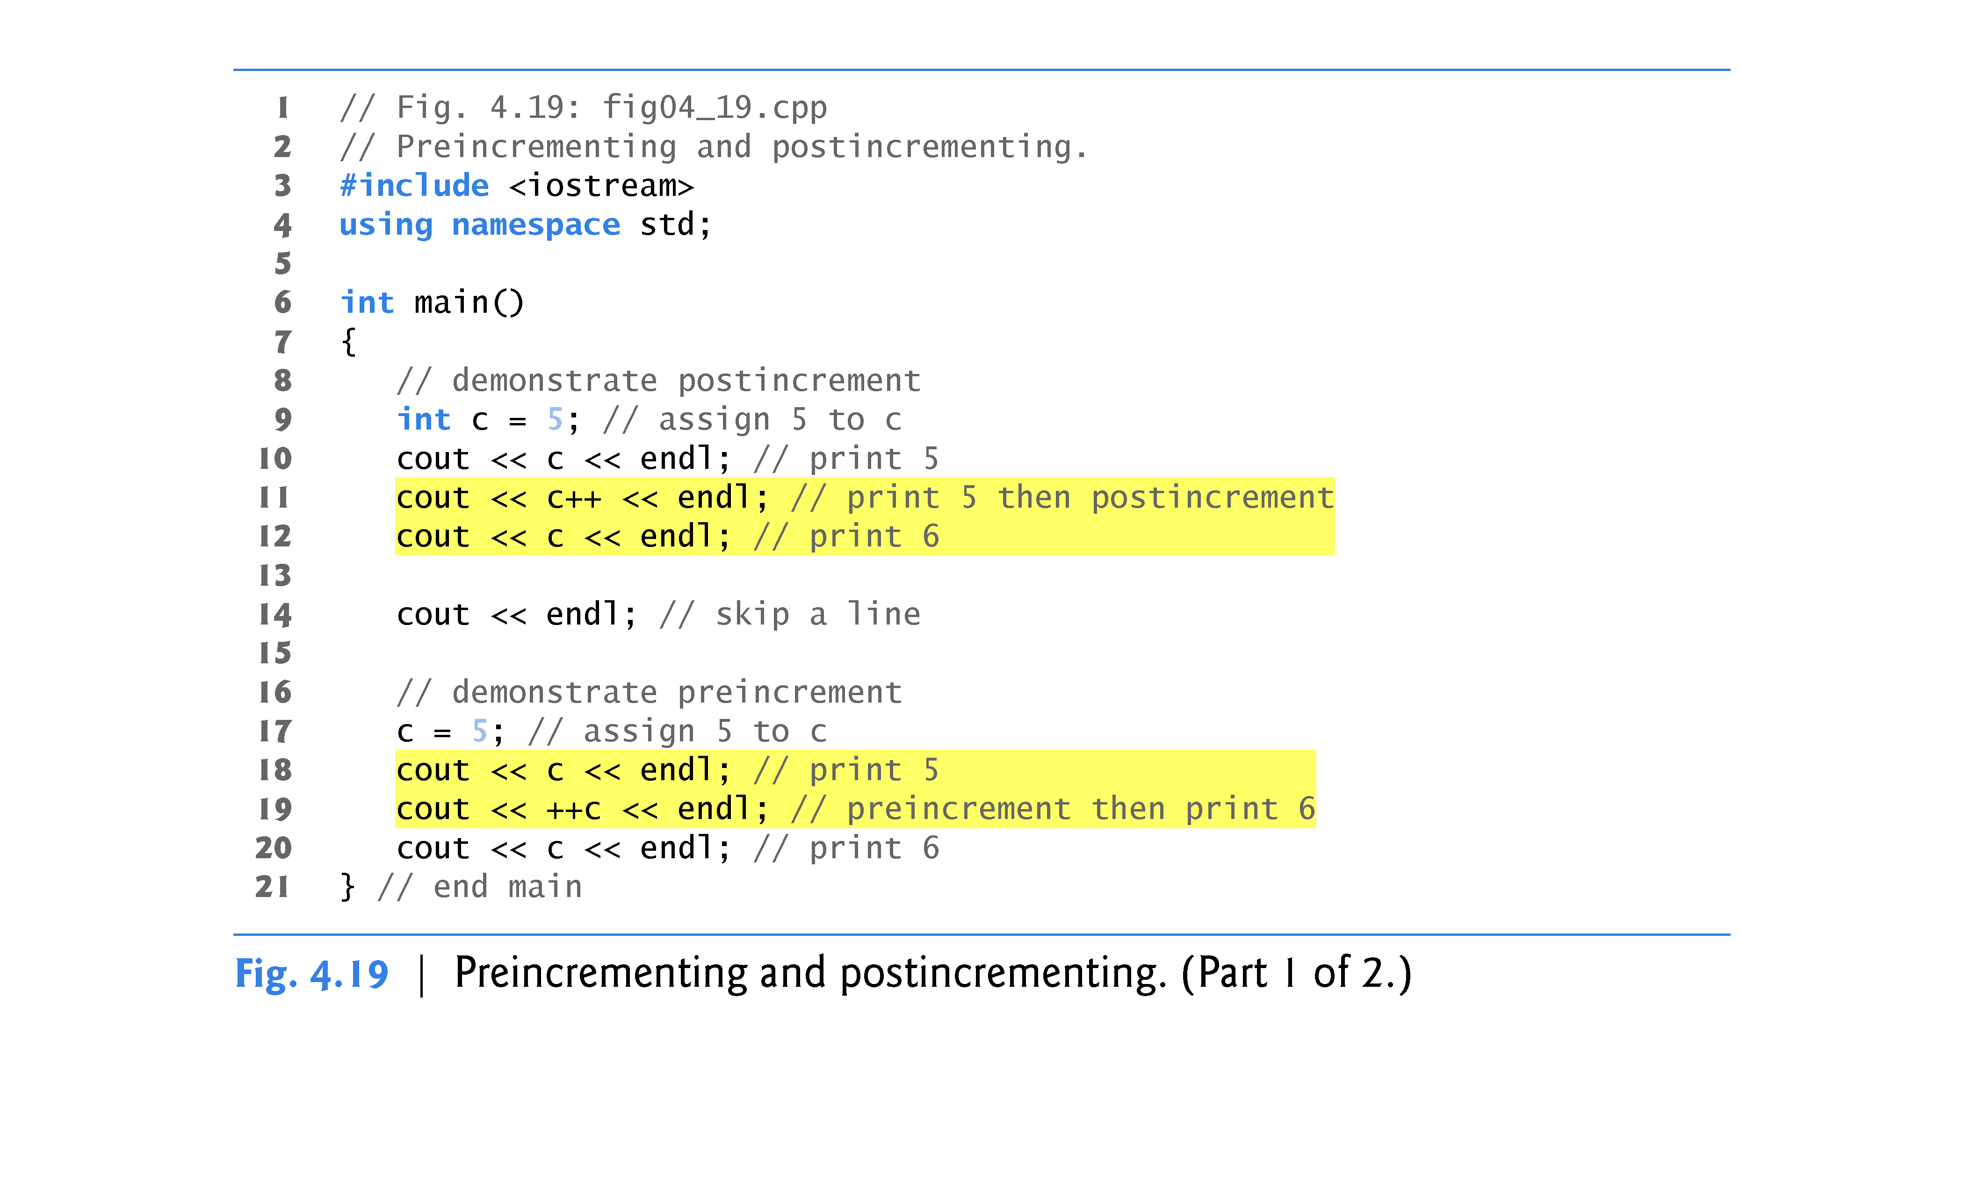

Slide 49
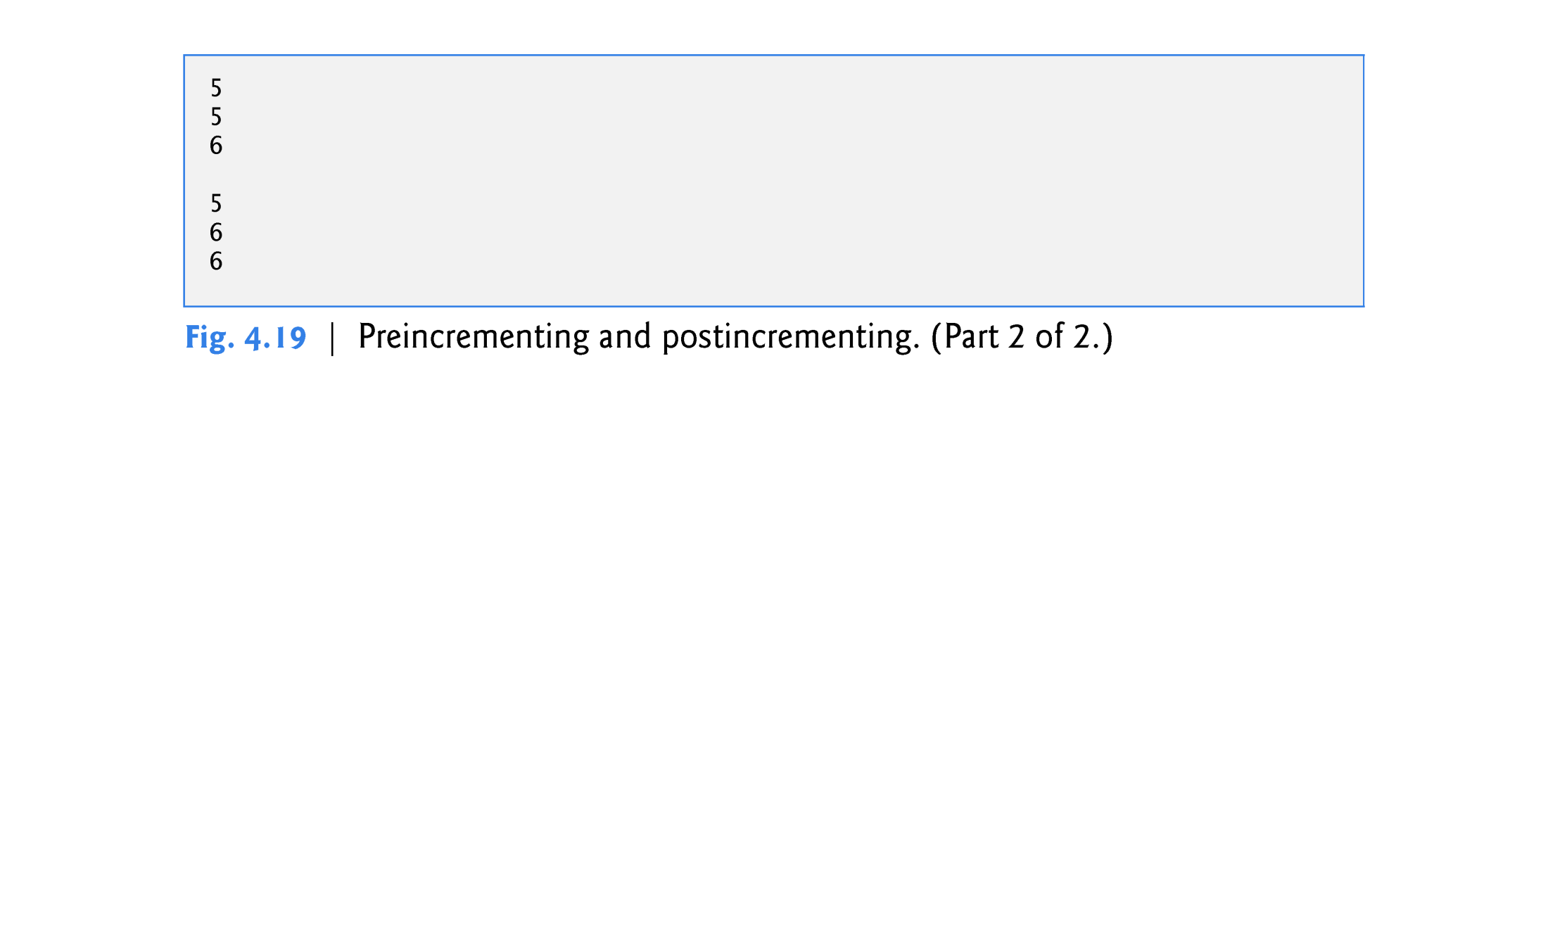

Slide 50
4.12 Increment and Decrement Operators (cont.)
When you increment (++) or decrement (--) a variable in a statement by itself, the preincrement and postincrement forms have the same effect, and the predecrement and postdecrement forms have the same effect.
It’s only when a variable appears in the context of a larger expression that preincrementing the variable and postincrementing the variable have different effects (and similarly for predecrementing and post-decrementing).
Figure 4.20 shows the precedence and associativity of the operators introduced to this point.

